Slide 1
Name : Kirthika.G
Register NO : 312210324
Department : B.com (general)
College name : gss Jain college for women

Slide 2
PROJECT TITLE
Employee performance Analysis Using Excel

Slide 3
Agenda
Problem statement
Project overview
End users
Our solution and preparation
Data set description
Modelling approach
Results and discussion
Conclusion

Slide 4
Problem statement
The organisation seeks to Improve overall workforce productivity and effectiveness by analysing employee performance. To address these issues the company has to rebust performance analysis framework that can
Assessment performance matric: identify and quantify relevant performance indicators .
Bench mark performance: Establish benchmark and performance standards.
Enhance feedback mechanisms: Improve the feed back process.
Analysis performance data: Utilise performance data to identify.

Slide 5
Project overview
Goal : To evaluate and enhance employee performance.
Purpose : To identify strength and weakness.
Resources : Performance management Software.
Data analysis tools.
HR and departmental Input.
Access performance channels.

Slide 6
End users
Managers and supervisors
Human resource professionals
Executive and senior leadership
Executive
Team leaders

Slide 7
Our solution and Its value proposition
Key features:
Real time analytics
Customizable dashboard
AI Powered insights
Value proposition
Data driven insights
Reduced turnover
Operational efficiency

Slide 8
Dataset description
Web site -
Features -
My analysis -
Employee Type
Starting date & endingDate
Gender : Male or female
Current employee rating & performance level etc

Slide 9
Modelling
Data collection
Kaggale
Download the employee dataset
Prepare the employee dataset
Features collection
There 26 features
My analysis are 9 features

Slide 10
Data cleaning
Identify the missing value
Missing value short & filter
Performance level
Very high
High
Medium or low
Summary
Pivot table
Graph to analyse

Slide 11
Visualization
Data collection
Rating the employees
Gender
Level of performance
Given Formula Of performance level

Slide 12
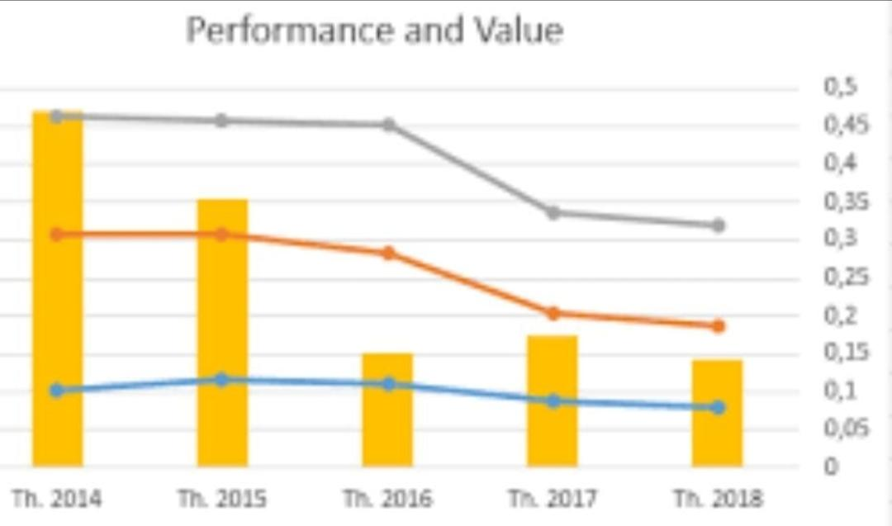
Results :

Slide 13
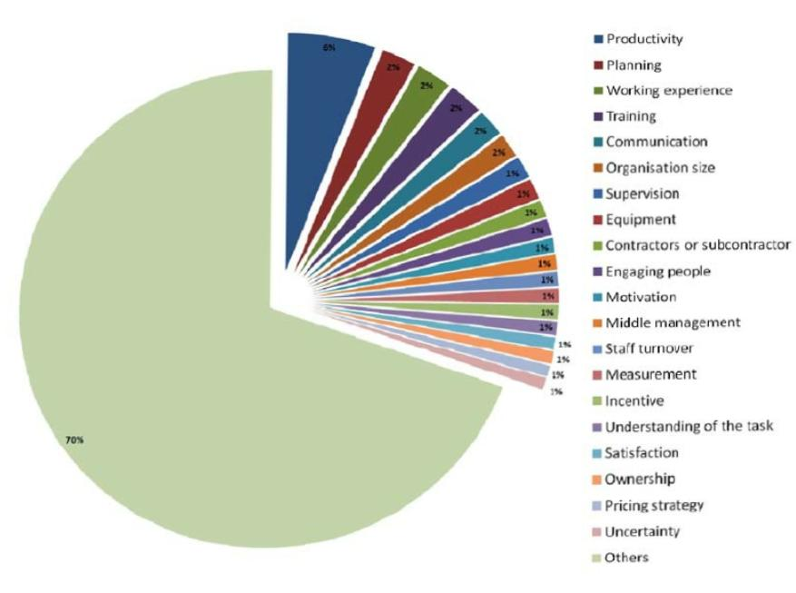
Result :

Slide 14
Conclusion
Excel can be used to analyze employee performance in a number of ways, including:
Templates
Excel templates can include areas for comments and observations, and can calculate average scores, identify top performers, and more.
Dashboard sheets
Summary dashboards can use charts, graphs, and conditional formatting to visualize performance metrics.

Slide 15
Formulas and functions
Basic formulas like SUM, AVERAGE, and COUNT can aggregate data and calculate KPIs. Advanced functions like VLOOKUP, INDEX/MATCH, and IF statements can also be used.
Pivot tables
Pivot tables can be used for dynamic data analysis, summarizing and filtering performance data.
Conditional formatting
Conditional formatting and rules can be used to automatically flag performance issues.
Charts and graphs
Bar and line charts can be used to visualize performance trends over time

